Slide 1
Notes:
Opening Graphic

Slide 2
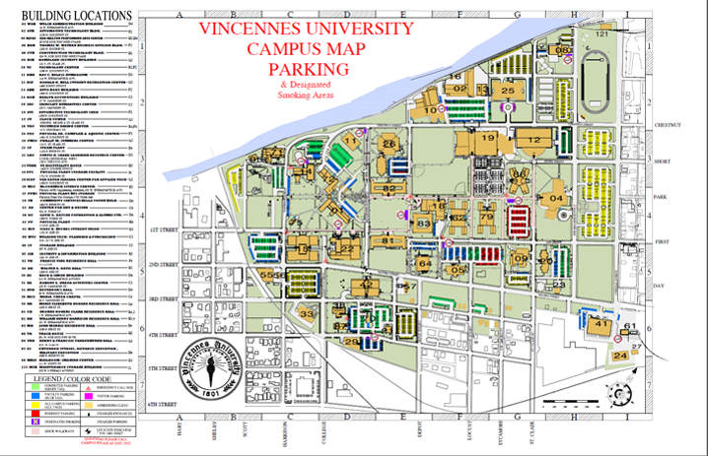
Before We Get Started...
Welcome to Campus
A Campus map
is included in your materials
and available online.
Notes:
Template Page – Duplicate and use as needed.

Slide 3
Before We Get Started...
Vincennes is a tobacco-free campus except for designated tobacco use areas.
The IT Lead, a student club on campus developed a free app called “Know Your Zones”
as a guide to designated areas.
Notes:
Template Page – Duplicate and use as needed.

Slide 4
Before We Get Started...
VanGo provides a set Walmart
run schedule for VU students:
Tuesdays & Fridays each semester
Pick Up Locations:
Next to Harrison Hall on Indianapolis Ave. &
On First St. between Godare and Vigo Halls
Pick Up Times:
1:30pm & approx. 2:30pm.
Notes:
Template Page – Duplicate and use as needed.

Slide 5
Before We Get Started...
To schedule a VanGo trip:
Monday-Fridays
Between 7:00am & 4:30pm
Vincennes Locations Only
Cost: $1.00
Call 886-3381 one day in advance to book
Must have a valid VU student ID to ride.
Notes:
Template Page – Duplicate and use as needed.

Slide 6
ADVISING LOCATION CHANGES
Physical Therapy Assistant Majors
Health Sciences Bldg. Room
Notes:
Template Page – Duplicate and use as needed.

Slide 7
STUDENT FINANCIAL SERVICES HELP
Student Financial Services representatives available to help!
WHERE: Welsh Administration Bldg.
WHEN: 12:30 PM – 4:00 PM TODAY!
Notes:
Template Page – Duplicate and use as needed.

Slide 8
Meal Plans and Dining Options Provided By
Notes:
Template Page – Duplicate and use as needed.

Slide 9
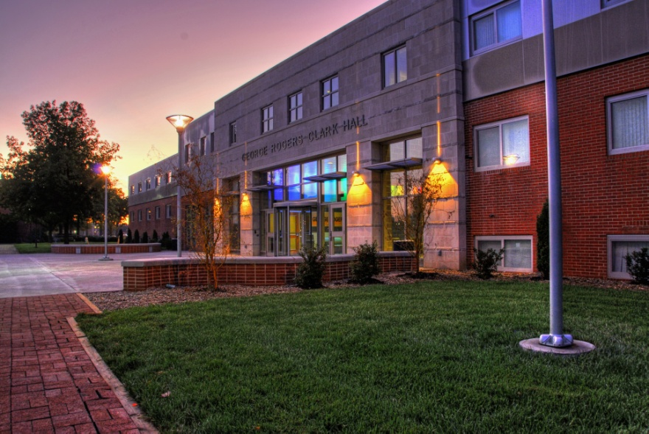
Housing and
Residential Life
Office located in
Clark Hall, Room 101
812.888.4225
housing@vinu.edu
Notes:
Template Page – Duplicate and use as needed.

Slide 10
The Success Center is located on 3rd floor of Davis Hall
Monday – Friday 8am - 4:30pm
Notes:
Template Page – Duplicate and use as needed.

Slide 11
Know Your
Advisor!
Start of School
Thursday, August 17– Residence Halls open 8:00 am
(You do not have to arrive on this day!)
Friday – Sunday Aug. 18, 19, 20
Drop and Add in the Ft. Sackville Rooms, Beckes Student Union
Monday, August 21- Classes Begin!!!
ALL students and Academic Advisors can access Degree Works. Utilize this tool every time you meet with your academic advisor to schedule your classes. This will ensure you are on track to fulfill your graduation requirements.
Parent & Family Session
Watch for the Back to School Letter
Notes:
Template Page – Duplicate and use as needed.

